Slide 1
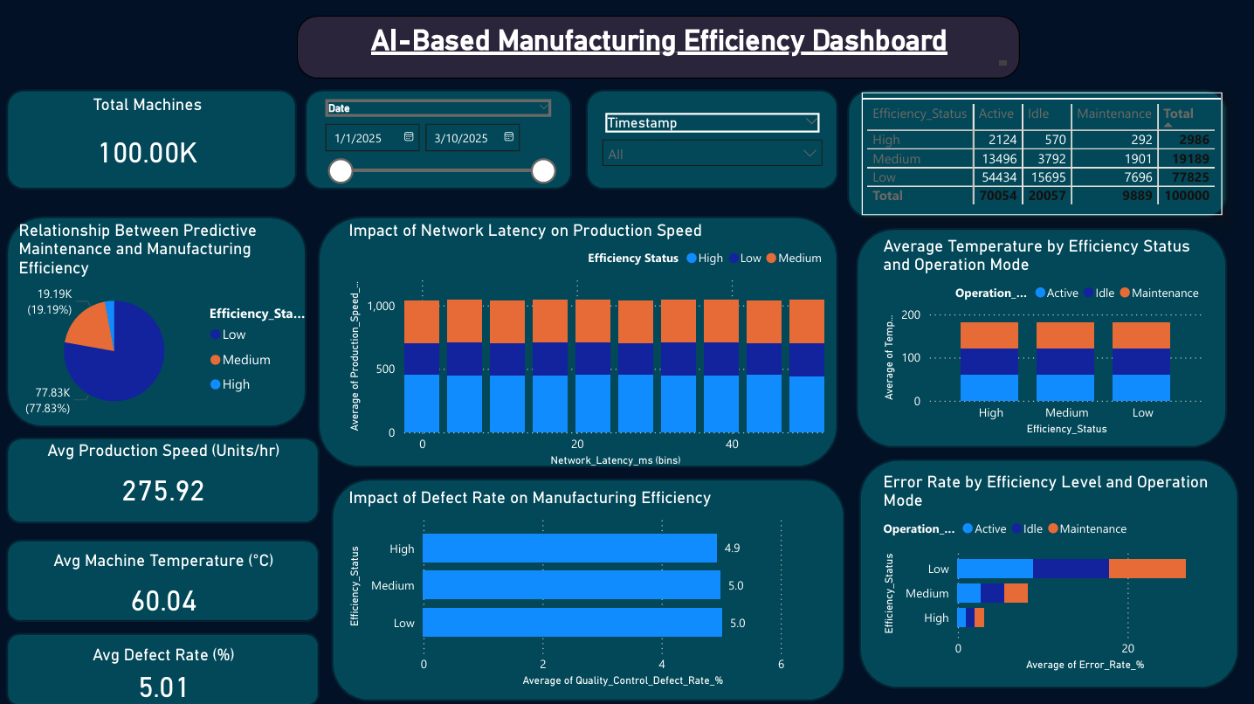

Slide 2
Project Overview & Insights
Analyzed manufacturing efficiency to identify key performance drivers using sensor, production, and network data.
Evaluated critical factors including network latency, machine temperature, defect rate, and error rate.
Built KPI-driven dashboards to monitor production performance and operational efficiency.
Designed interactive visualizations to analyze efficiency across operation modes (Active, Idle, Maintenance).
Developed a Power BI dashboard to enable real-time monitoring and support data-driven decision-making.

Slide 3
Dashboard Explanation
• The dashboard analyzes manufacturing efficiency by combining production, sensor, and network data to identify performance drivers.
• Low efficiency is strongly associated with higher defect rates and error rates, indicating quality issues directly impact production performance.
• Increased network latency negatively affects production speed, highlighting the importance of network performance in smart factories.
• Machine conditions such as temperature influence efficiency levels, emphasizing the need for continuous operational monitoring.
• Comparison across operation modes (Active, Idle, Maintenance) reveals efficiency variations and helps identify performance gaps.
• Low efficiency conditions represent the highest risk to production performance and operational stability.
• The dashboard enables real-time monitoring and supports proactive decision-making to improve efficiency and reduce production losses.

Slide 4
Conclusion
• This project demonstrates how data analytics can be used to monitor and improve manufacturing efficiency.
• Key factors such as defect rate, error rate, and network latency significantly impact production performance.
• The dashboard provides actionable insights that help identify inefficiencies early and support data-driven decision-making.
• This solution can help reduce production losses, improve operational efficiency, and enable smarter decision-making in manufacturing environments.
• The approach can be extended to build intelligent and automated monitoring systems in smart factories.

